Slide 1
CLASS IX ARTIFICIAL INTELLIGENCE PART A
UNIT-2: SELF-MANAGEMENT SKILLS

Slide 2
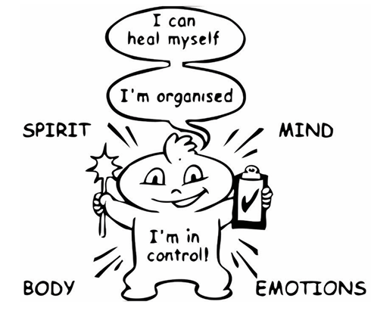
1.INTRODUCTION:
Self-Management Skills Self-management, which is also referred to as ‘self control’ or ‘self-regulation’, is the ability to regulate one’s emotions, thoughts, and behavior effectively in different situations.
This includes motivating oneself, and setting and working towards personal and academic goals.
Self-management involves understanding yourself, understanding what your interests and abilities are, having a positive attitude and grooming yourself in order to develop self-confidence.
Self-management can also help in:
• developing good habits
• overcoming bad habits
• reaching your goals
• overcoming challenges and difficulties
Being able to manage yourself helps you to avoid stress and provides opportunities
to get involved in fun activities.
Who Am I?

Slide 3
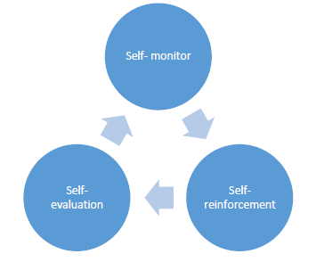
2. Positive Results of Self-Management
• It guides individuals to self-monitor their conduct and behavior. Students, once become aware that they are responsible for their behavior, they become pro-active.
o Prepares individual to complete the task independently.
o Instills ownership to the task and the consequences amongst individuals.
Helps in setting individual goals . Self-management makes individuals realize that they need to do course correction by themselves if they do not get desired goals. Once the goals are achieved as desired, it also motivates individuals.
Directs evaluation of performance, objective resetting and enhances self-esteem.
It helps in self-evaluation
It leads to self – reinforcement of positive behavior . Self-management reinforces appropriate behavior of students as per the time, situation and people involved. It motivates individuals to take up right things and refrains from getting indulged into negative things, keeping long term consequences in focus.
o Enforces self-learning for goal achievement
o Self-reliance is enhanced and which reinforces the behavior.

Slide 4
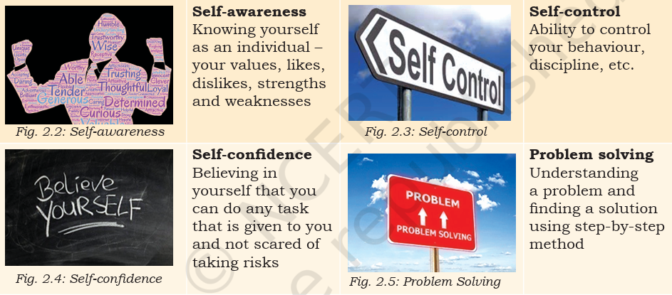
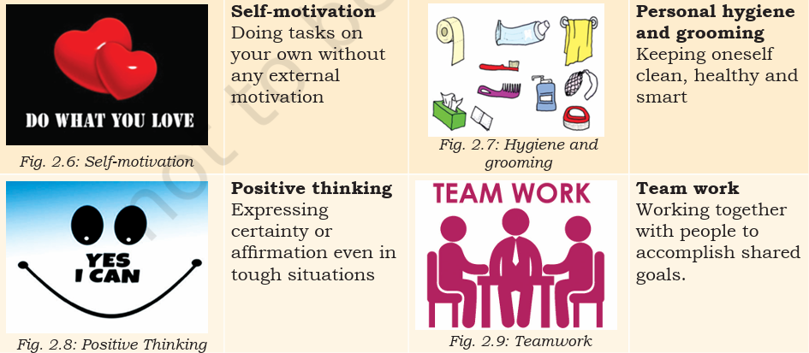
3. Self-management skills include the following:

Slide 5
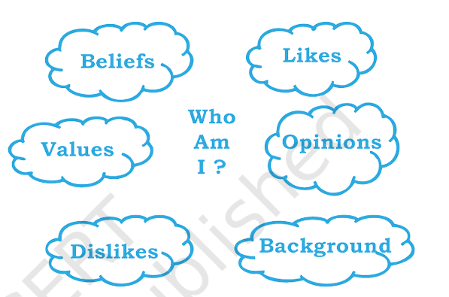
STRENGTH AND WEAKNESS ANALYSIS:
Knowing what you do well or not so well, will help you in converting your weaknesses into strengths and strengths into an exceptional performance. The strength and weakness analysis helps you in this process. Strength and weakness analysis begins with knowing yourself first.
KNOWING YOURSELF :
It means understanding who you are, what you like, what you do not like, what are your beliefs, what are your opinions, what is your background, what you do well and what you do not do well?

Slide 6
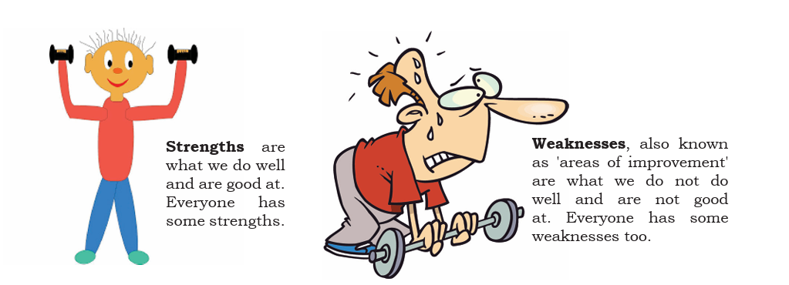

Slide 7
IDENTIFYING STRENGTHS
• Take time off to think about what you do well
• Think of anything that you are always good at
• Think about what others appreciate about you
IDENTIFYING WEAKNESSES
• Point out the areas where you struggle and what you find difficult to do
• Look at the feedback you receive from others
• Be open to feedback and accept your weaknesses without feeling small about it. Look at it as an area of improvement.
4. Self-Confidence
Realistic belief and trust of an individual in one’s own judgement, capabilities and worthiness is self-confidence.
Factors that help in building self confidence
• Social : Interactions with family and social environment, like friends, relatives, teachers and media influences self-confidence of individuals. Development of confidence on self is a process which results from the experiences of individuals while interacting with others.
• Cultural :Cultural factors comprise of values, beliefs and customs. Indians give higher importance to family values, believe in the philosophy of “Vasudhev Kutumbhkam” and follow custom of celebrating Diwali. Conforming to cultural values, beliefs and customs enhances self-confidence.
Physical : Physical self-efficacy, physical activity and social physique anxiety are found to be influencing self-confidence of individuals. Physical activity is found to be directly related to self-confidence. Physical self-efficacy refers to physical potential to complete a given task. Social physique anxiety is a concern amongst individuals about perceived evaluation of one’s physical self by the society.

Slide 8
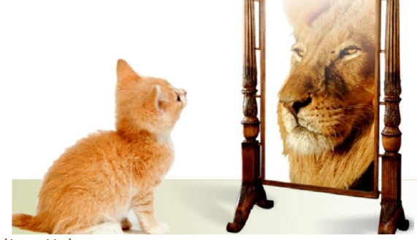
5. Self-Confidence Building Tips
1. Getting rid of negative thoughts
Going away from negative thoughts takes individuals closer to a peaceful positive mind. To travel away from negative thoughts, individuals need to involve themselves in an activity – take a walk, draw, sing, dance, chat, watch, read or talk.
2. Thinking positively
Positive thinking brings brain to a peaceful stance and increases productivity and performance. When individuals start thinking positively, they feel happy from within and their self-confidence boosts up.
3. Staying happy with small things : An individual who is full of gratitude for every small blessing in his life feels contended. Being thankful towards people and the world, instills confidence in individuals.
4. Staying clean, hygienic and smart : Personal hygiene is the first key to a confident person. Keeping hair, teeth, fingers, body and skin clean and well maintained is an easy and effective way to be at best.
5. Chatting with positive people : Interacting with positive people brings forth a fresh and progressive perspective to life. People in similar stages of life go through similar issues. Some positively handle these situations, and interacting with them shall help boost confidence

